Slide 1

Communicating Your Science
Colors of the Brain Workshop
August 1, 2024
Lauren!
Science Communication is How Society Talks About Science. Allea—All European Academies. https://allea.org/massimiano-bucchi-science-communication/
Notes:
Heading font: playfair display
Body font: montesserant

Slide 2
Why is it important?
Avoids the spread of misinformation!
(a very real) example: the pandemic
People should know what you’re working so hard on!

Slide 3
Know your audience and cater to them!

Slide 4
Different Settings for Communication
1
2
Purely Verbal
Presentations
Example: Elevator Pitch
Example: poster, lab meeting, TED talk
Cater! To! Your! Audience!
To the General Public
To a Scientific Community

Slide 5
Different Settings for Communication
1
2
Purely Verbal
Presentations
Example: Elevator Pitch
Example: poster, lab meeting, TED talk
Cater! To! Your! Audience!
To the General Public
To a Scientific Community

Slide 6
Elevator Pitch
Goals
Your ABC’s
Explain your research to a universal audience
- Answer the typical: What? How? Why?
- Avoiding the use of jargon
Keep the talk under 2 minutes
Maintain enthusiasm when talking about your research!
A is for your audience
B is for background, balance, and benefit
C is for concise, clear content

Slide 7
Different Settings for Communication
1
2
Purely Verbal
Presentations
Example: Elevator Pitch
Example: poster, lab meeting, TED talk
Cater! To! Your! Audience!
To the General Public
To a Scientific Community

Slide 8
Presentation Flow
#1
Background
Give your audience a platform
#2
What and Why
State what your goal is and why it is important
#3
Walk through what you did and what you found
Methodology and Results
#4
Summary
Relay main findings, future directions, and acknowledgments

Slide 9
Presentation Tips
Be concise, direct, and simple
Avoid wordy/busy slides!
Create a Story!
Give your audience time to digest
Be confident and enthusiastic

Slide 10
Example Slides

Slide 11
Big Question:
Is there a compartmentalization component to RNA damage and RBP dysfunction in ALS?

Slide 12
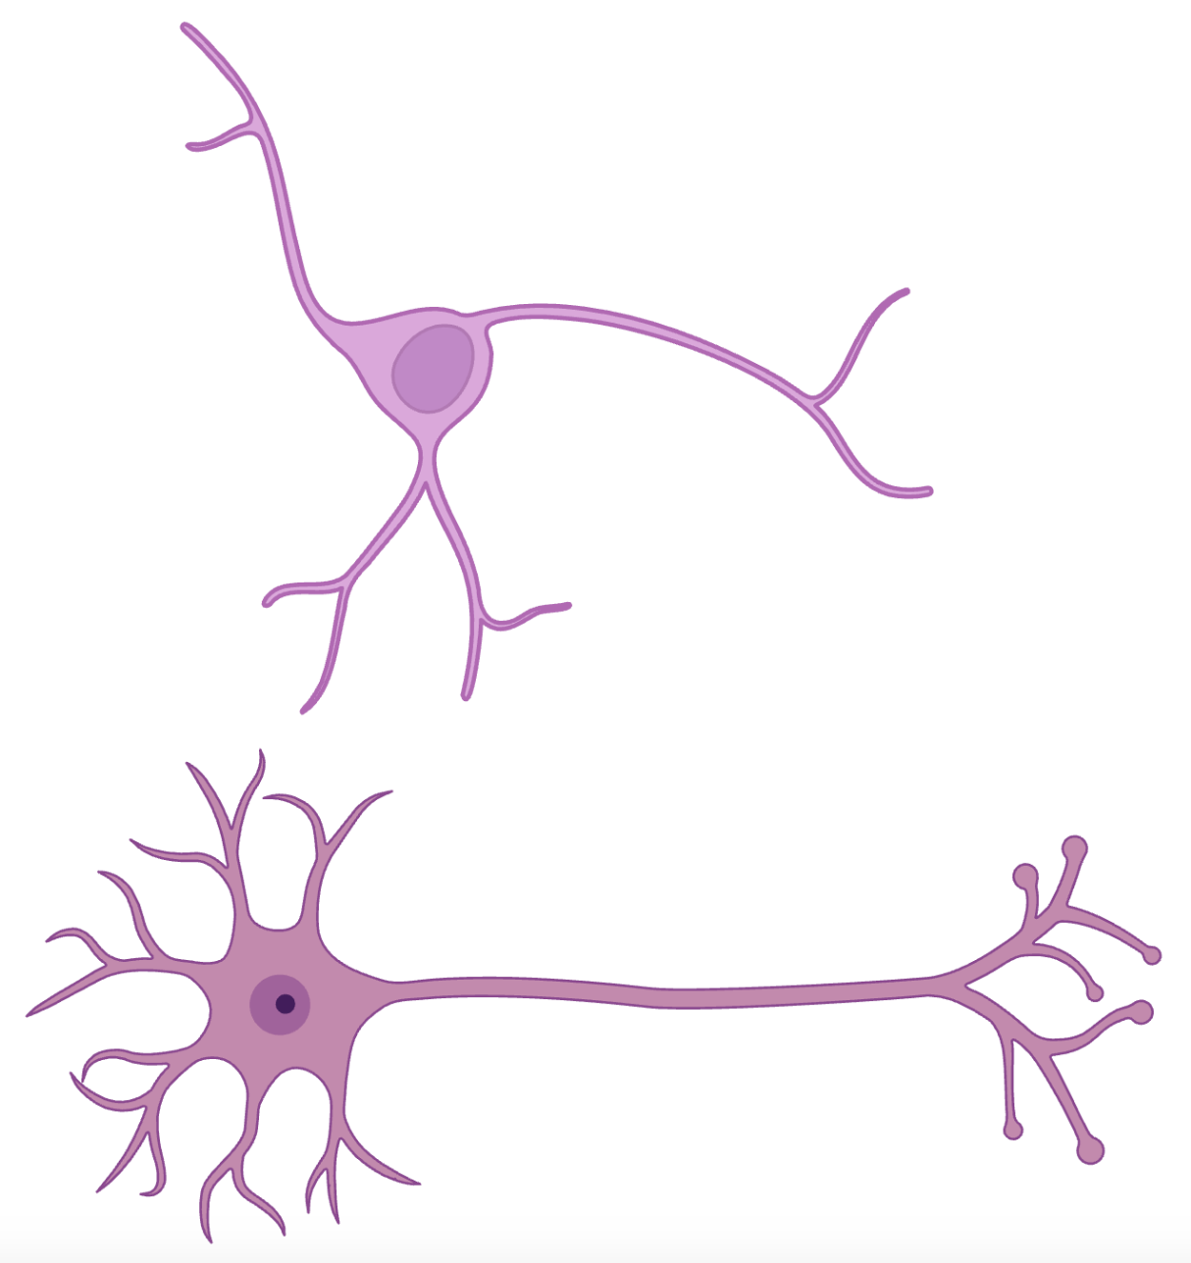
Neuronal Compartments to Study
1. dendrites
3. axon
Cortical Neuron
2. soma
4. Pre-synaptic terminal
Motor Neuron

Slide 13


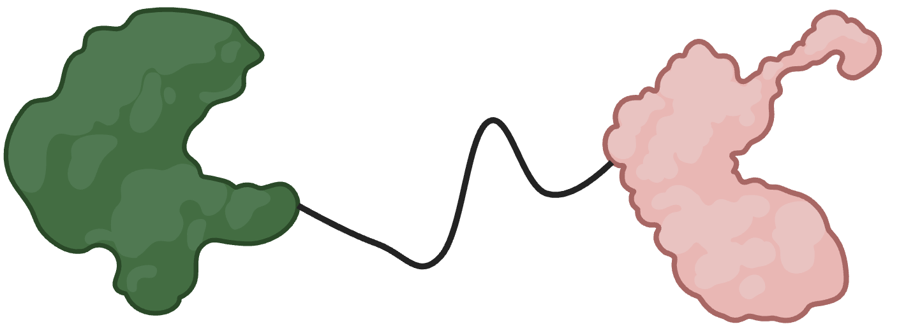
Creation of a SuperNova Fusion Protein
A Method for Localizing SuperNova to Compartments
SuperNova Sequence
Protein of Interest (POI) Plasmid
POI - SuperNova Fusion Plasmid
POI
SuperNova
There are plenty of proteins that strictly go to each compartment:
PSD95 → Dendrites
Soma
Actin → Axon
Synaptobrevin → Pre-synaptic Terminal

Slide 14
Your Conferences
Summer Research Conference
CoB Symposium
10 minutes of presenting
General crowd of people
X minutes of presenting
A more neuroscience focused crowd of people

Slide 15
Your Concerns
How in-depth should I go when presenting?

Slide 16


